Slide 1
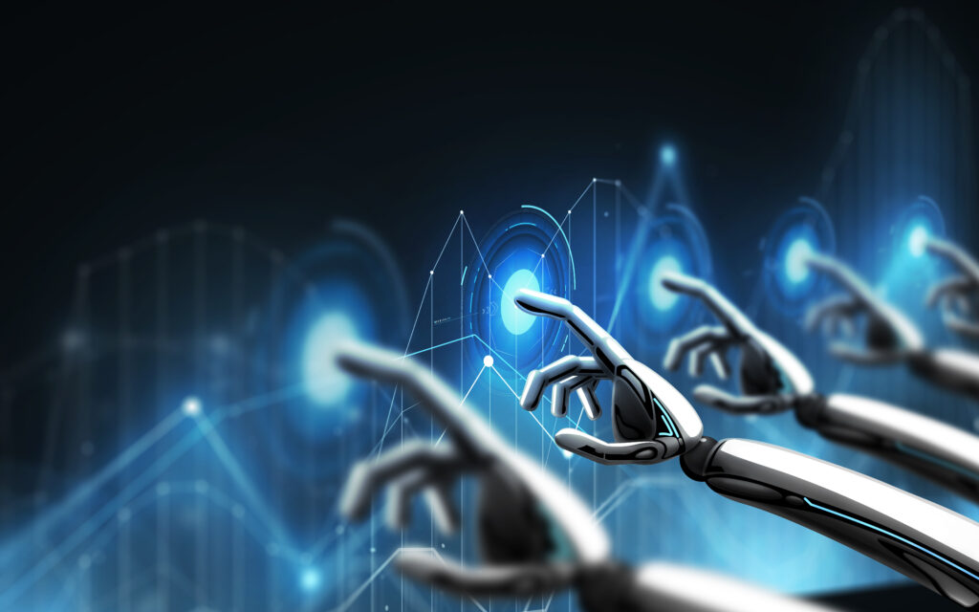
Disease Prediction Using Machine Learning

Slide 2

Team Members:
Venkata Mallikharjuna Rao Pola
Lohith Vamsi Bellamkonda
Venkata Rami Reddy Yarram
Narasimha Raj Kumar Madasu
Arun Sairam Nuvvula

Slide 3
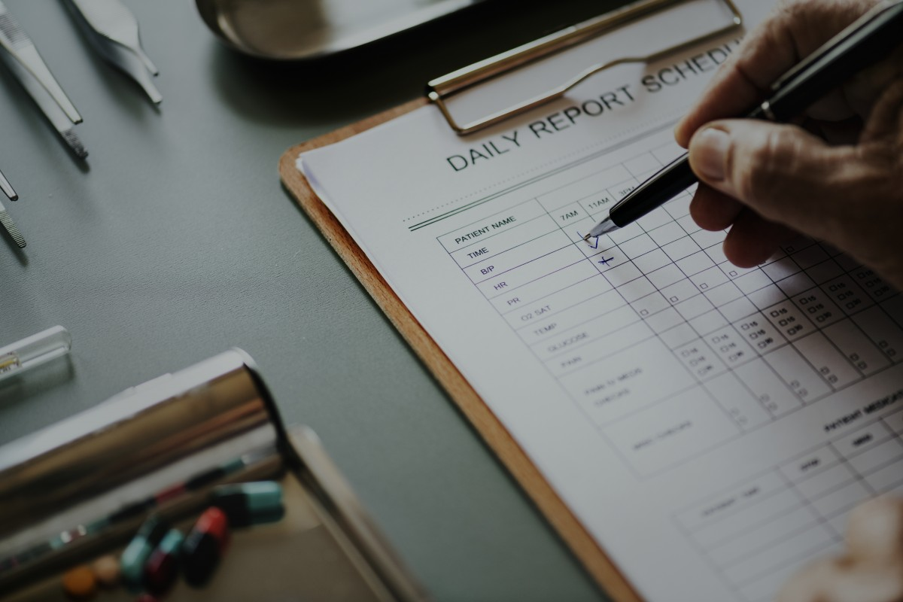
Content:
Introduction
Problem Definition
Proposed Solution
App Features
Demo
Future Enhancements
Conclusion

Slide 4
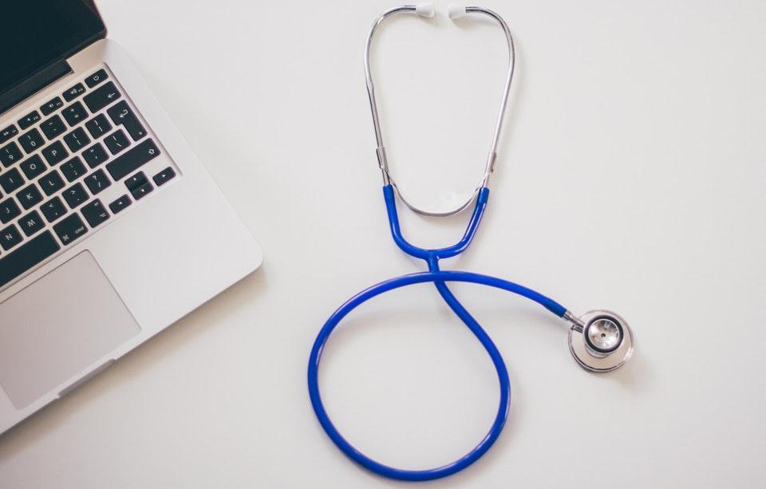
Introduction
Our project's primary objective is to innovate disease prediction by employing machine learning techniques. This initiative is aimed at advancing early diagnosis and improving patient care.
We specifically target heart disease, lung cancer, skin cancer, and various brain diseases, recognizing the significance of early detection in these conditions.
To achieve our goals, we utilize advanced algorithms tailored to the complexities of each disease. This ensures precision and effectiveness in our predictive models.
By harnessing vast amounts of data and employing sophisticated methodologies, we strive to empower healthcare professionals with the tools necessary for more informed decision-making and enhanced patient care.
Ultimately, our mission is to contribute to positive patient outcomes by facilitating early intervention and providing healthcare professionals with the means to deliver superior care.

Slide 5
Problem Definition
Our project is committed to transforming healthcare using machine learning to accurately predict diseases.
The app focuses on various health issues like heart, lung, skin, and brain diseases, giving users personalized health advice tailored to their needs.
We use data-driven models to address the tough task of spotting diseases early, allowing for proactive treatment.
Our main aim is to help people control their health by providing them with the tools and information needed to manage their well-being effectively, leading to better health results.

Slide 6
Proposed Solution
We are launching a complete healthcare package using machine learning to predict heart, lung, skin, and brain diseases.
Our cool Android app uses fancy algorithms like Random Forest for heart issues, Convolutional Neural Networks for lung cancer, and special models for skin and brain problems.
With easy-to-use screens, predictions that come instantly, and always getting better, our app wants to change how we find diseases early and make patients better.

Slide 7
App Features
1. Multi-Disease Prediction:
- Anticipate the likelihood of heart, lung, skin, and brain diseases all in one app.
2. Easy-to-Use Interface:
- Create a simple interface for effortless data entry and easy understanding of results.
3. Instant Predictions:
- Offer immediate health forecasts based on the information users provide.
4. Easy-to-Understand Predictions:
- Explain predictions in plain language so users can grasp them easily.
5. Privacy and Safety:
- Implement strong measures to safeguard user information and adhere to healthcare rules.
6. Personalized User Profiles:
- Let users set up profiles to track their health and receive customized suggestions.

Slide 8
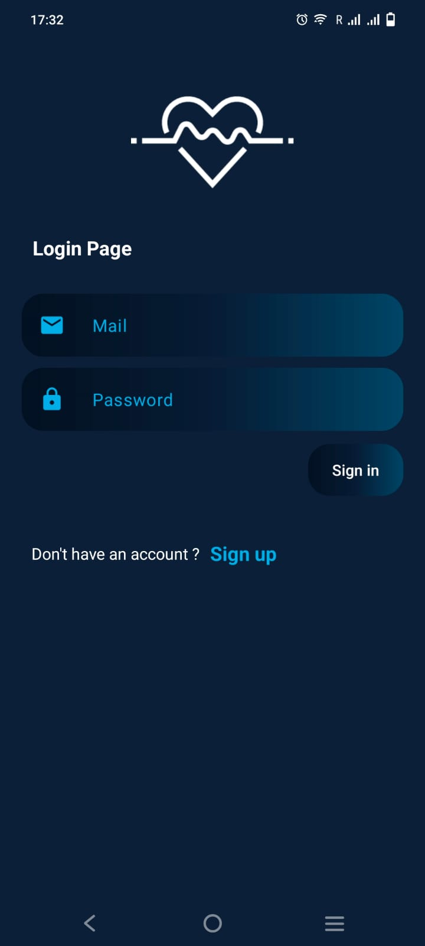
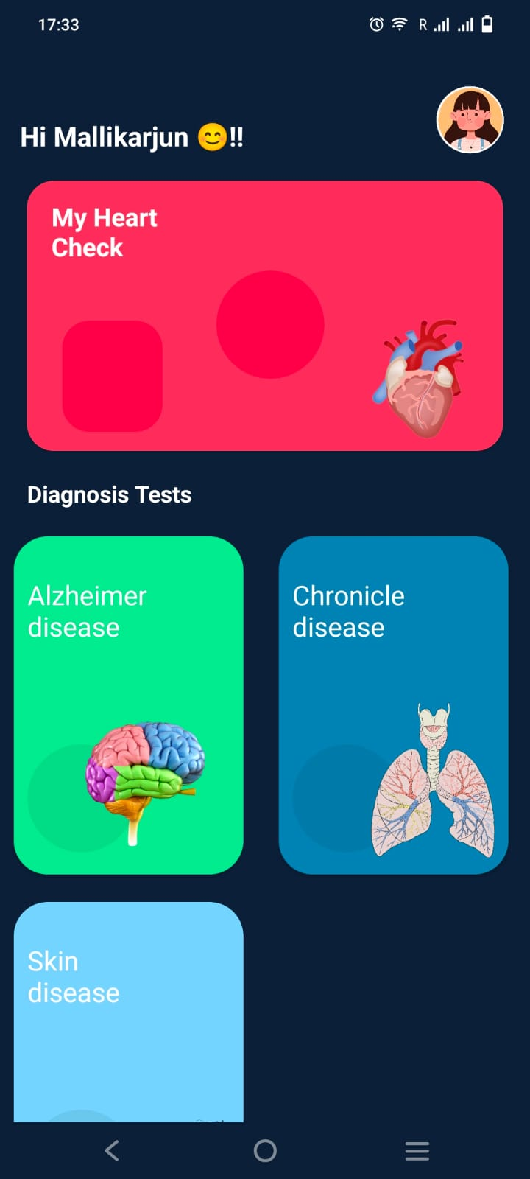
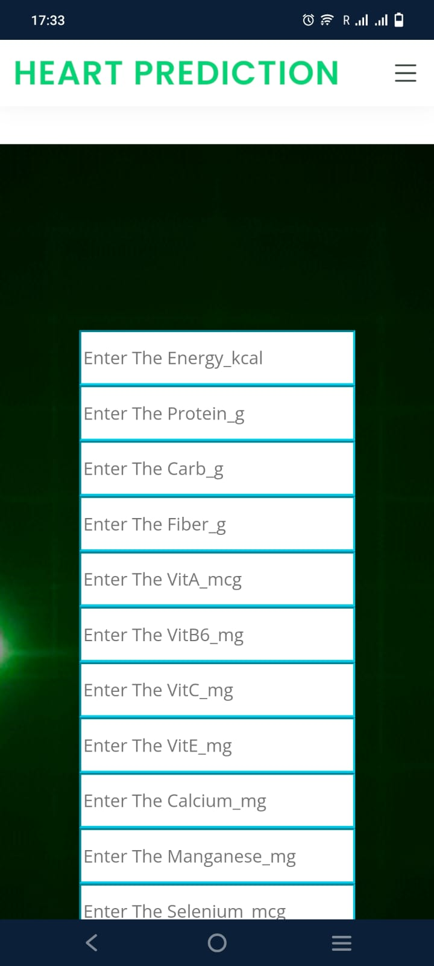
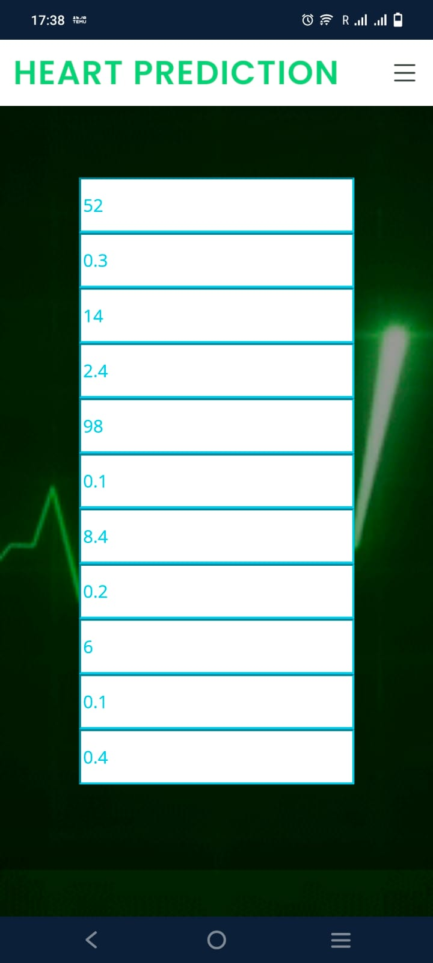
Visual Overview of our App

Slide 9
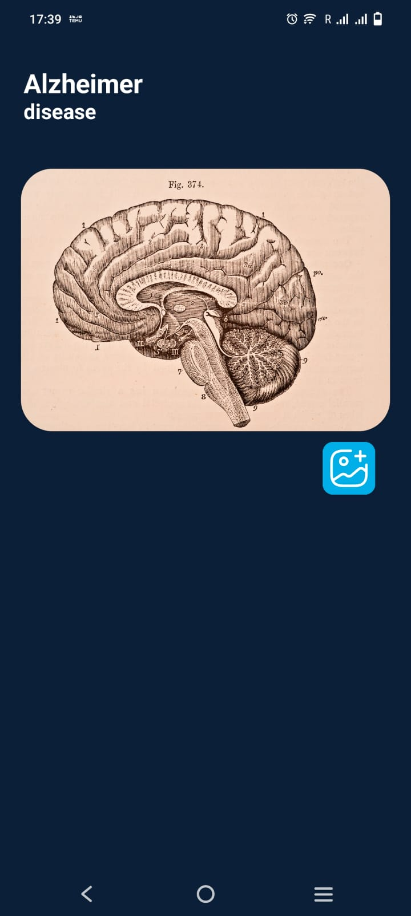
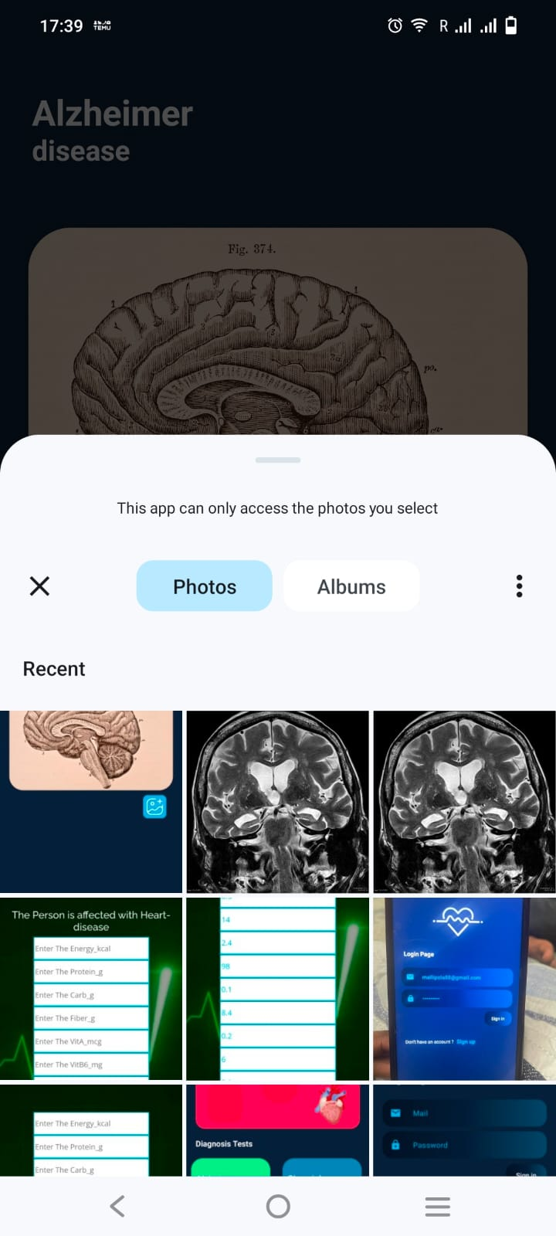
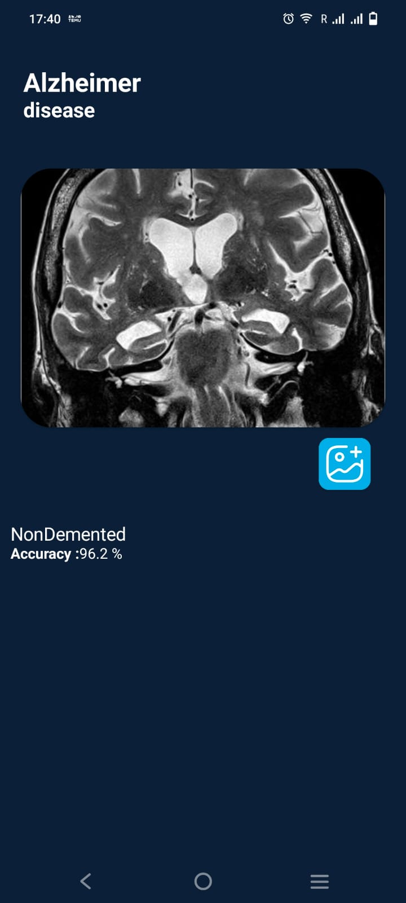
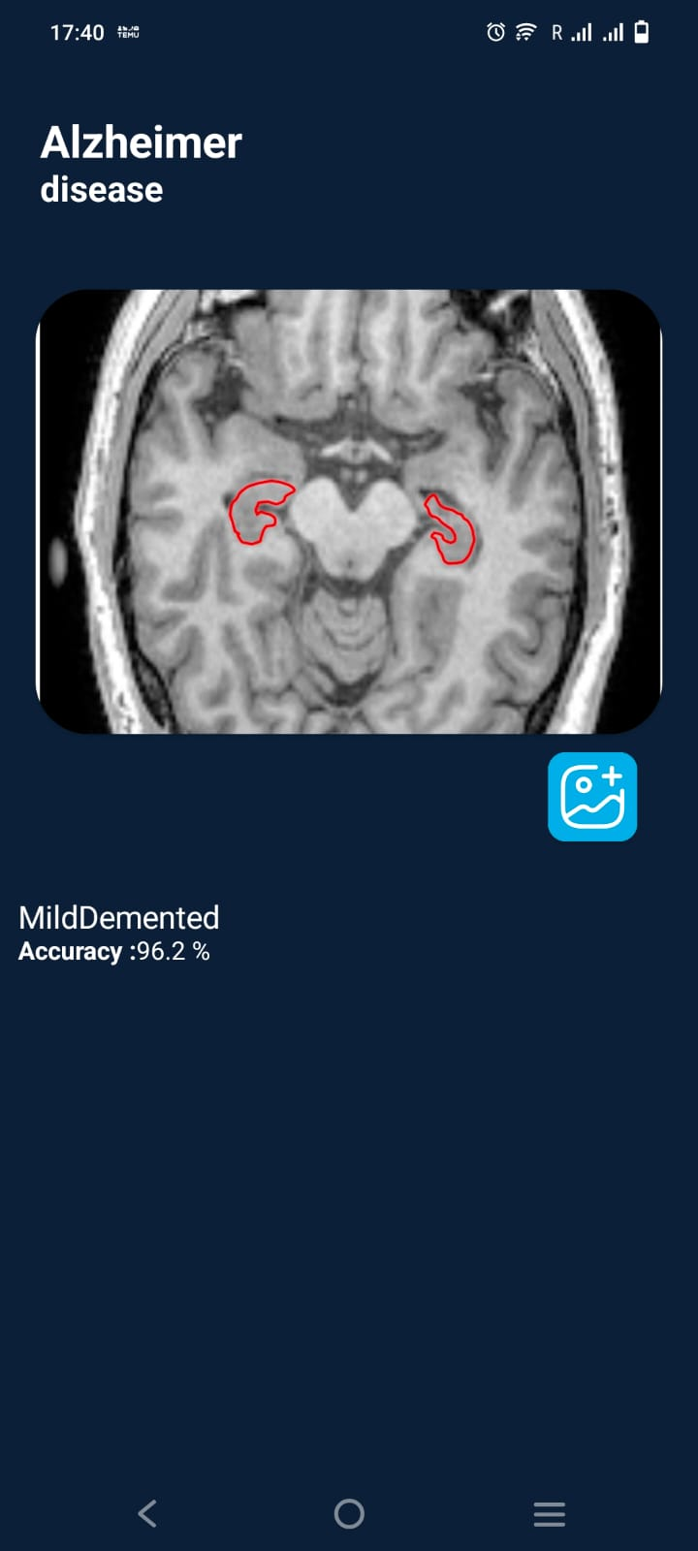
Visual Overview of our App

Slide 10
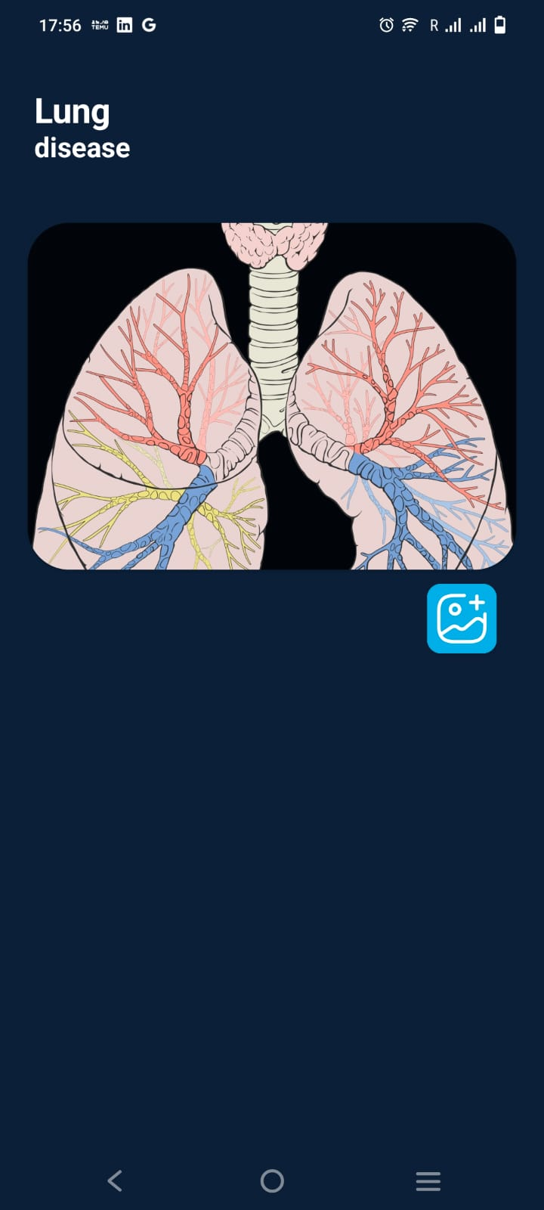
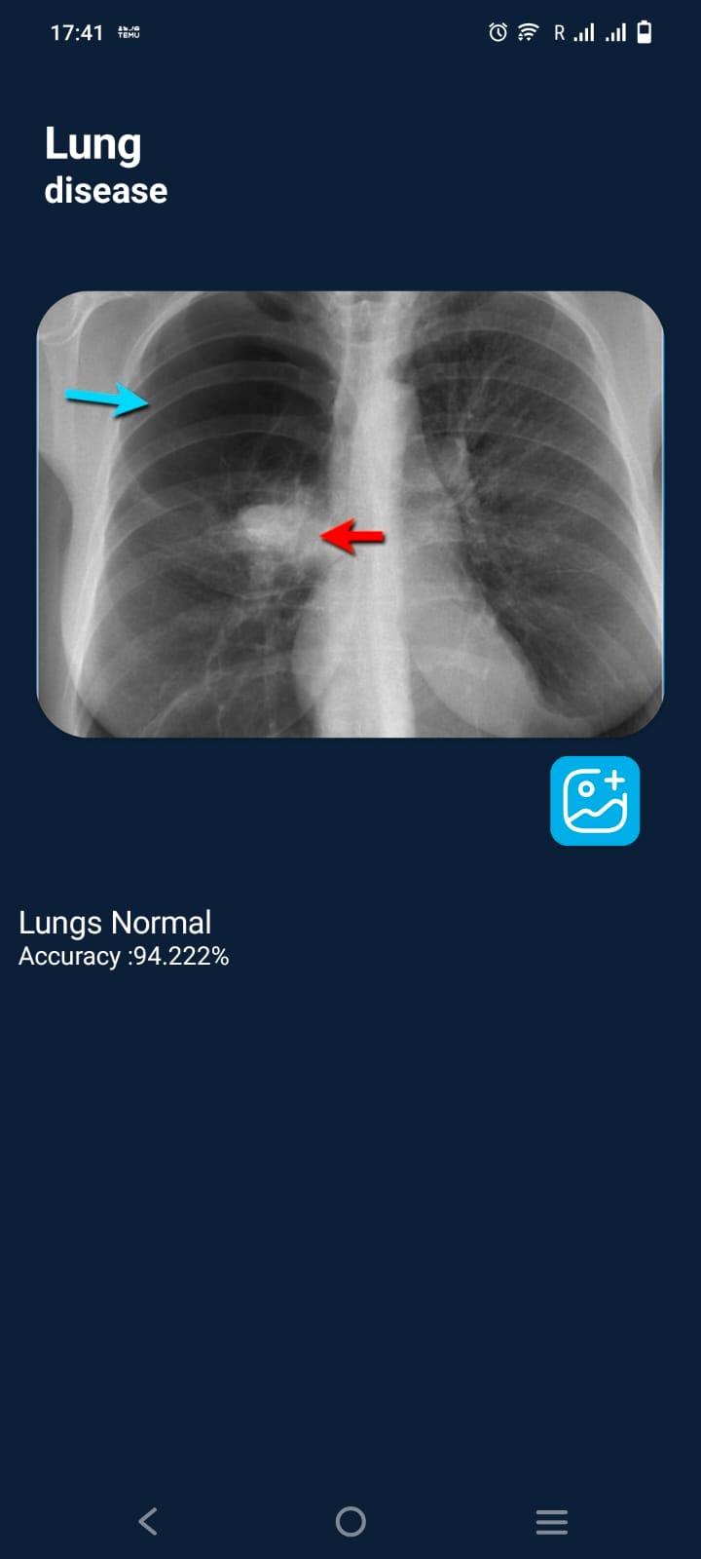
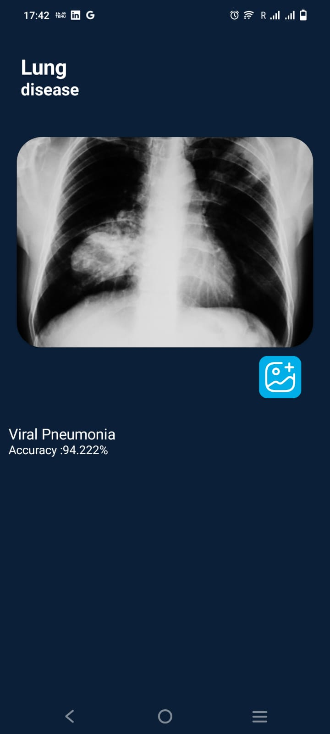
Visual Overview of our App

Slide 11
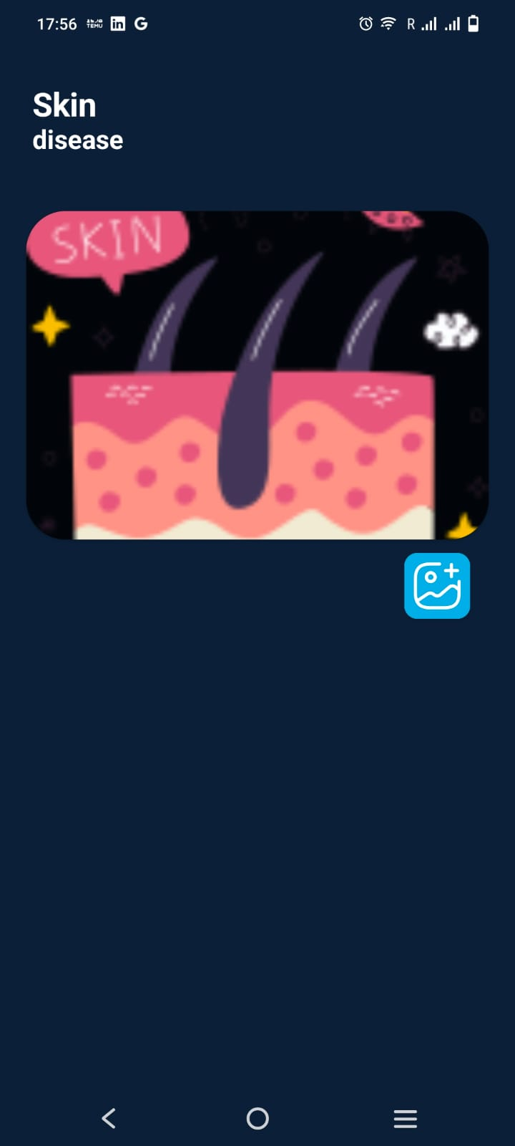
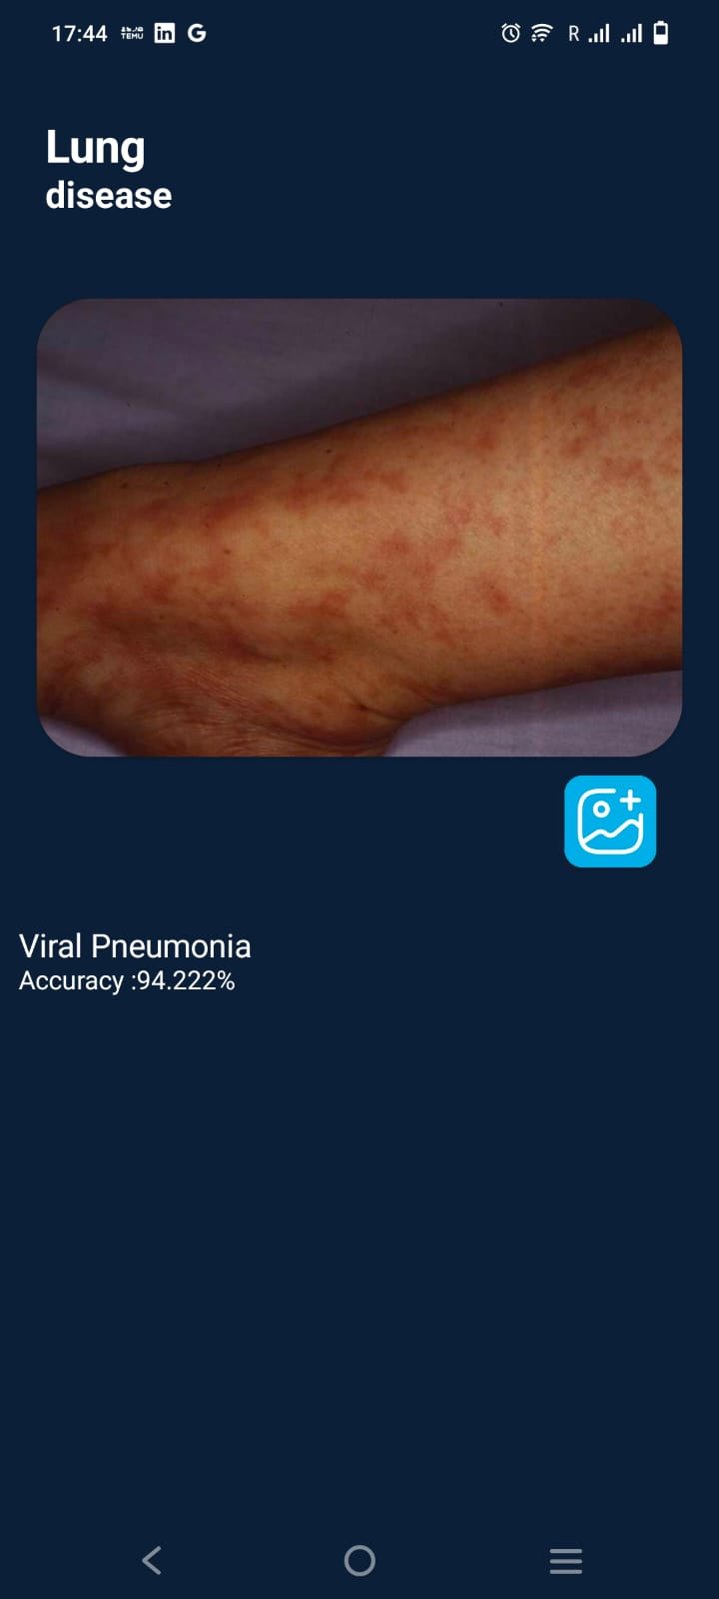
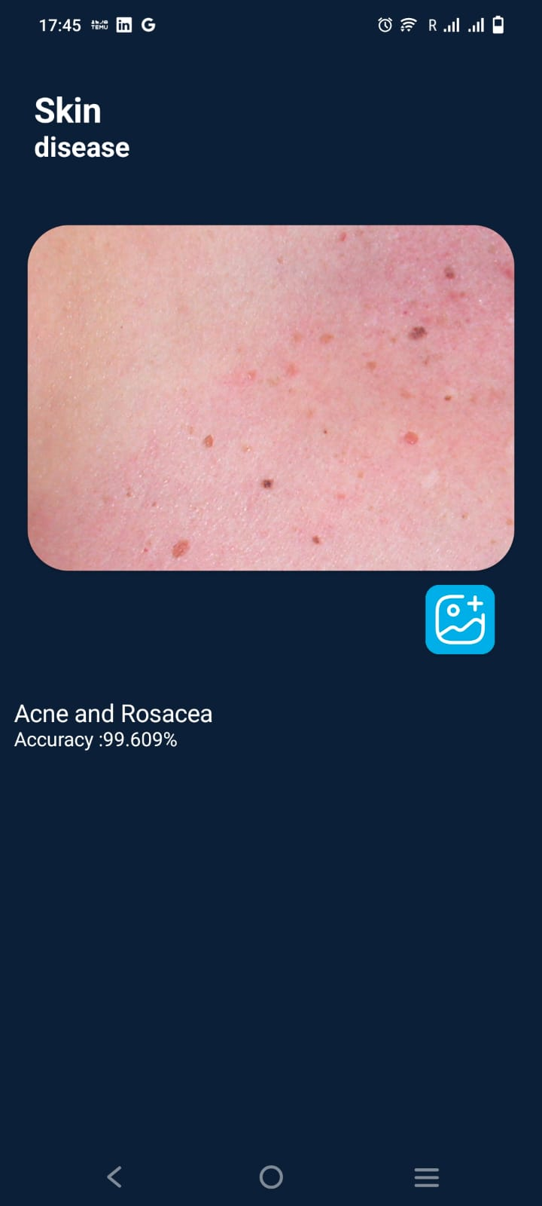
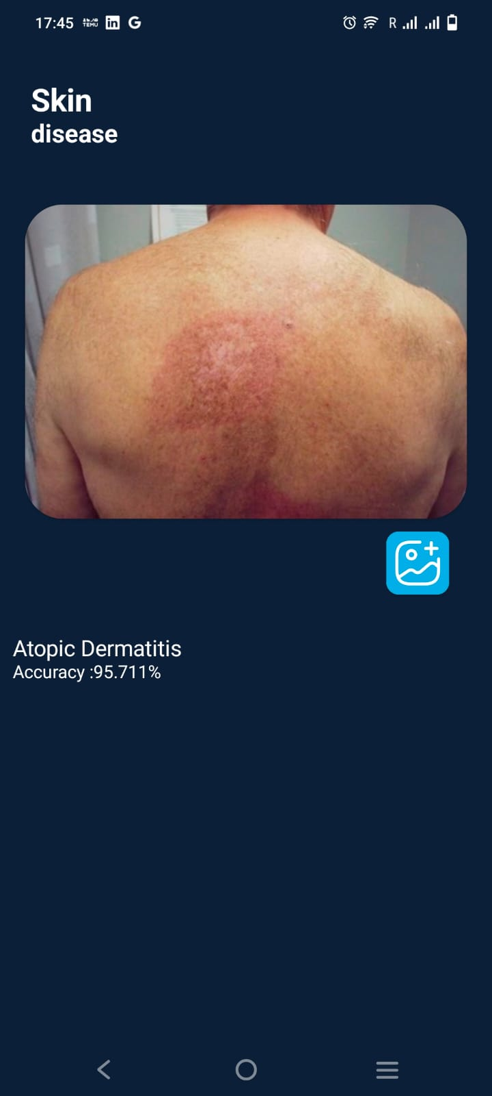
Visual Overview of our App

Slide 12
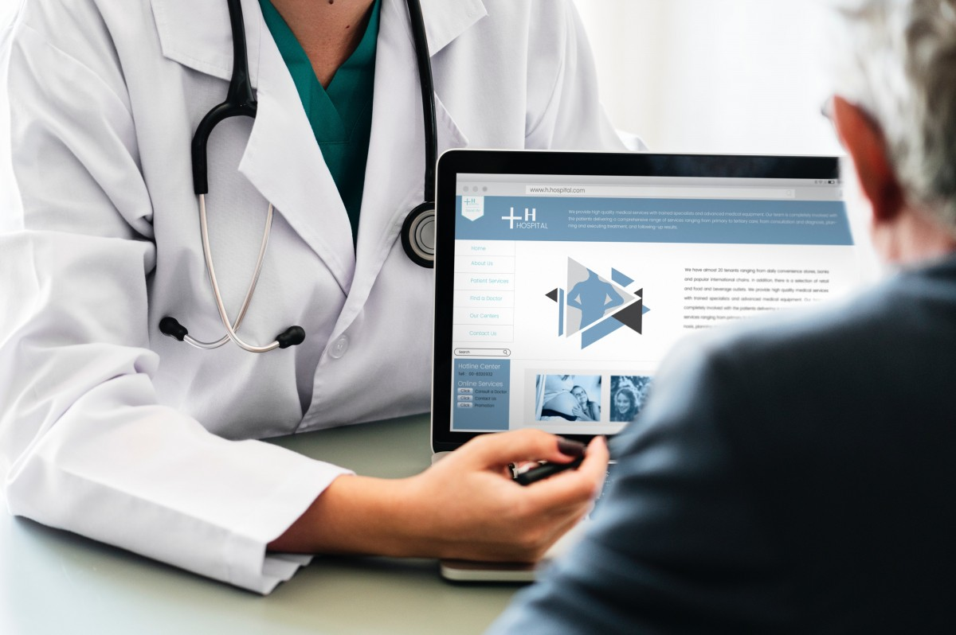
DEMO

Slide 13
Future Enhancements
1. Fun Health Tips:
- Make a cool feature that gives people helpful health tips based on what they think might happen, to help them make better choices for staying healthy
2. More Diseases Covered:
- Talk about more illnesses that might happen, so the app can help with even more health worries people might have.
3. Better Health Pictures:
- Make pictures about health stuff easier to understand, so people can see how they're doing with their health over time.
4. Friends with Fitness Apps:
- Work together with popular apps for exercising and eating right, so people can see everything they're doing for their health in one place.
5. Health Help Nearby:
- Give advice and resources about staying healthy that are just right for where someone lives, so they can get the best help for their health needs.

Slide 14
Conclusion
Our health app is simple to use and tells you if you might get heart, lung, skin, or brain diseases.
It helps you manage your health easily.
You get your results instantly, so you can learn about your health quickly.
We make sure your personal information stays private.
We're always working on making the app better and more accurate.
Our main goal is to give you easy-to-understand health advice tailored to you.
We already cover heart, brain, and lung diseases well.
Now, we're adding predictions for skin problems to make our app even better for looking after your health.

Slide 15


